Slide 1
Chapter 6: Synchronization Tools

Slide 2
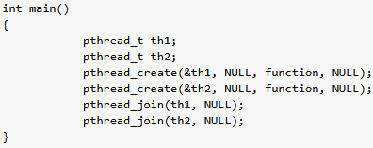
Important Note (1)
Do notserialize your multi-process or multi-threaded code by placing wait() or pthread_join() to force an execution order.
Clarify with your teacher if you unable to get this?
The above code only ordering guarantees here are that pthread_join(th1, NULL); will not return until thread 1 has exited and pthread_join(th2, NULL); will not return until thread 2 has exited. Consequently, the main() function will not return (and the process will not exit) until both thread 1 and thread 2 have exited.

Slide 3
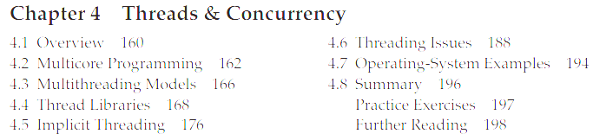
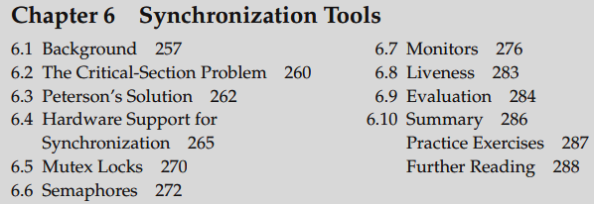

Slide 4
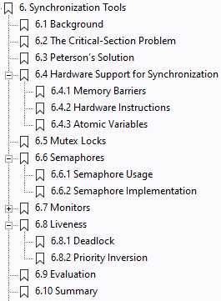




Concrete Theoretical understanding needed with textbook examples.
Student must have a basic understanding of these concepts
Concrete Theoretical understanding needed +
Student should be able to write Pthread C code using Mutex Locks and Semaphores.

Slide 5
Race Condition
Occurs when multiple processes/threads access shared data concurrently, and outcome depends on non-deterministic order of execution.
Leads to inconsistent results if synchronization mechanisms. How?
Critical in multi-threaded/multi-process programs.

Slide 6
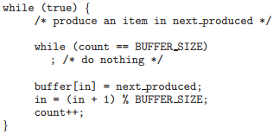
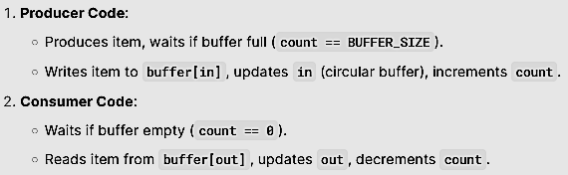
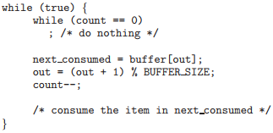
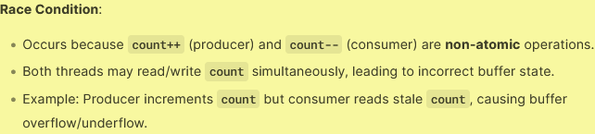
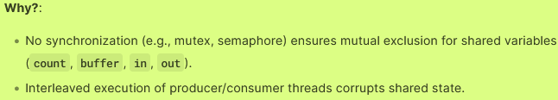
Producer
Race Condition
Consumer

Slide 7


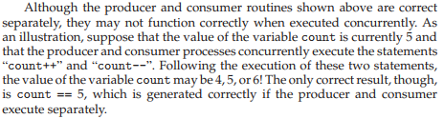
Race Condition
A situation where several processes access and manipulate the same data concurrently and the outcome of the execution depends on the particular order in which the access takes place, is called a race condition.

Slide 8


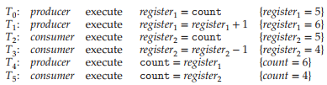
Race Condition

Slide 9
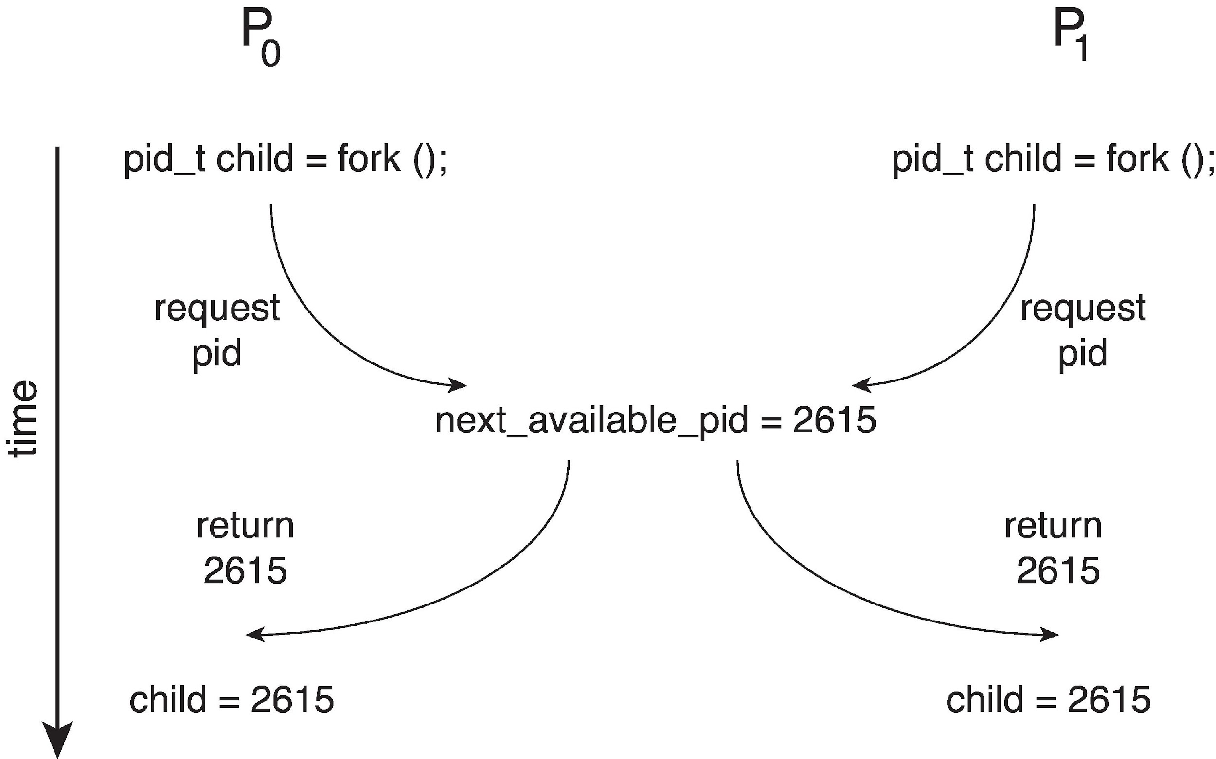
Race Condition
Processes P₀ and P₁ are creating child processes using the fork() system call
Race condition on kernel variable next_available_pid which represents the next available process identifier (pid)
Unless there is a mechanism to prevent P₀ and P₁ from accessing the variable next_available_pid the same pid could be assigned to two different processes!
See larger diagram on the next slide.

Slide 10
Explain race condition here in your own words

Slide 11
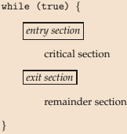
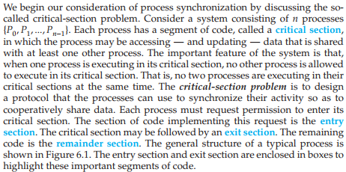
Critical Section Problem

Slide 12
Critical Section Problem
P0/T0
P1/T1

Slide 13

How we solve CS Problem in Code?

Slide 14
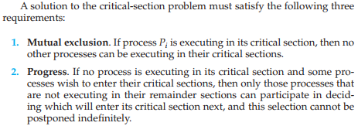

Critical Section Problem

Slide 15
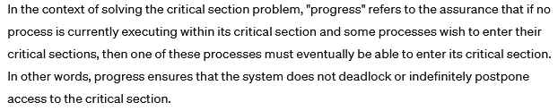
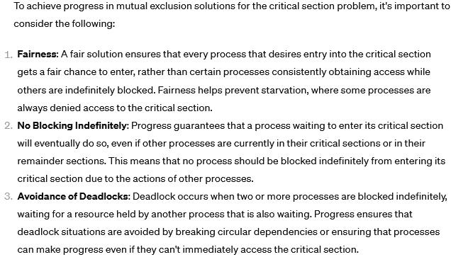
What is progress?

Slide 16
Interrupt-based Solution
Entry section: disable interrupts
Exit section: enable interrupts
Will this solve the problem?
What if the critical section is code that runs for an hour?
Can some processes starve – never enter their critical section.
What if there are two CPUs?

Slide 17
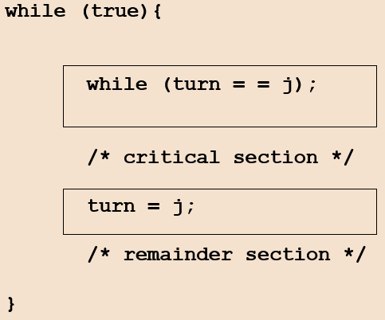
Software Solution 1
Two process solution
Assume that the load and store machine-language instructions are atomic; that is, cannot be interrupted
The two processes share one variable:
int turn;
The variable turn indicates whose turn it is to enter the critical section
initially, the value of turn is set to i
Mutual exclusion is preserved
P_{i} enters critical section only if:
turn = i
and turn cannot be both 0 and 1 at the same time
What about the Progress requirement?
What about the Bounded-waiting requirement?

Slide 18

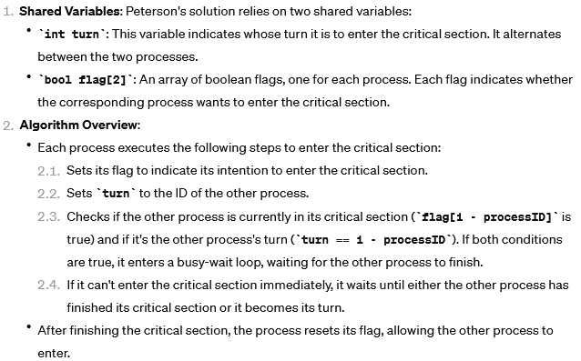
Peterson’s Solution

Slide 19
Peterson’s Solution
Two process solution
Assume that the load and store machine-language instructions are atomic; that is, cannot be interrupted
The two processes share two variables:
int turn;
boolean flag[2]
The variable turn indicates whose turn it is to enter the critical section
The flag array is used to indicate if a process is ready to enter the critical section.
flag[i] = true implies that process P_{i} is ready!

Slide 20
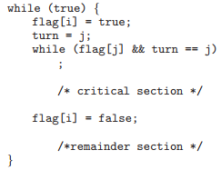
Algorithm for Process P_{i}

Slide 21
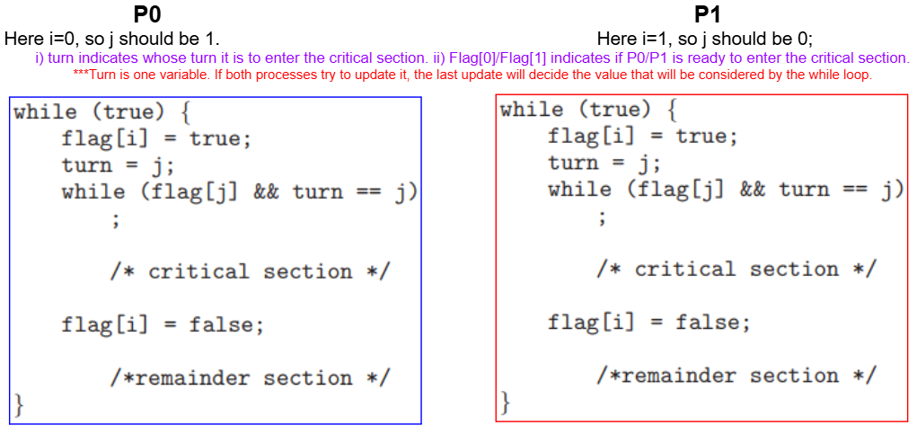
Dry run of Peterson’s solution

Slide 22
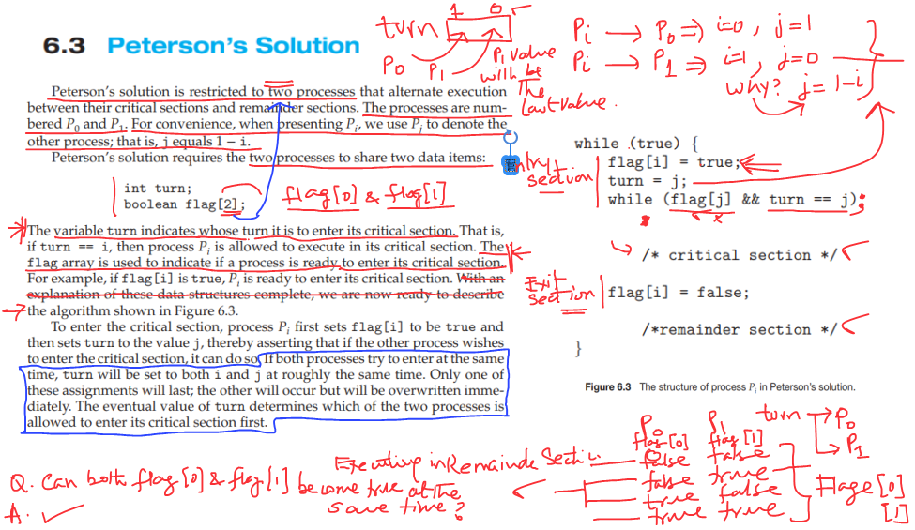
Peterson’s Solution

Slide 23
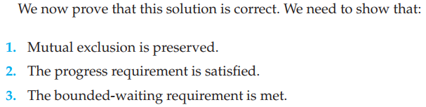
Correctness of Peterson’s Solution

Slide 24
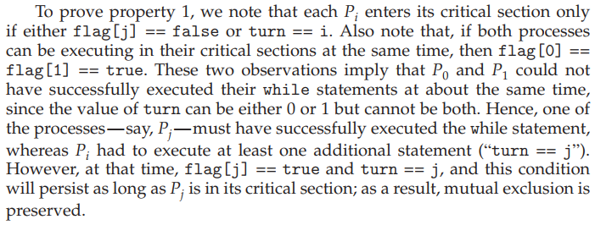

Slide 25

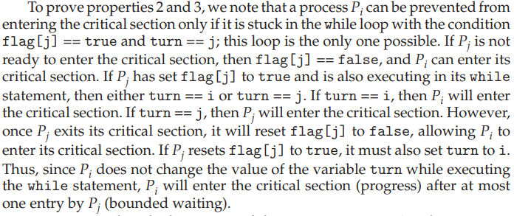

Slide 26
Peterson’s Solution and Modern Architecture
Software-based solutions for mutual exclusion are not guaranteed to work on modern computer architectures.
Peterson’s solution is not guaranteed to work on modern computer architectures for the primary reason that, to improve system performance, processors and/or compilers may reorder read and write operations that have no dependencies.
For a single threaded application, this reordering is immaterial as far as program correctness is concerned, as the final values are consistent with what is expected.
But for a multithreaded application with shared data, the reordering of instructions may render inconsistent or unexpected results.

Slide 27
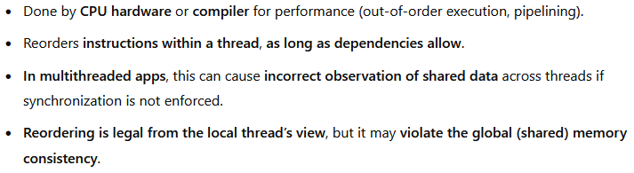
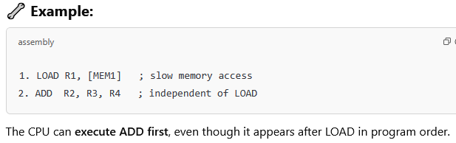
Instruction Reordering

Slide 28
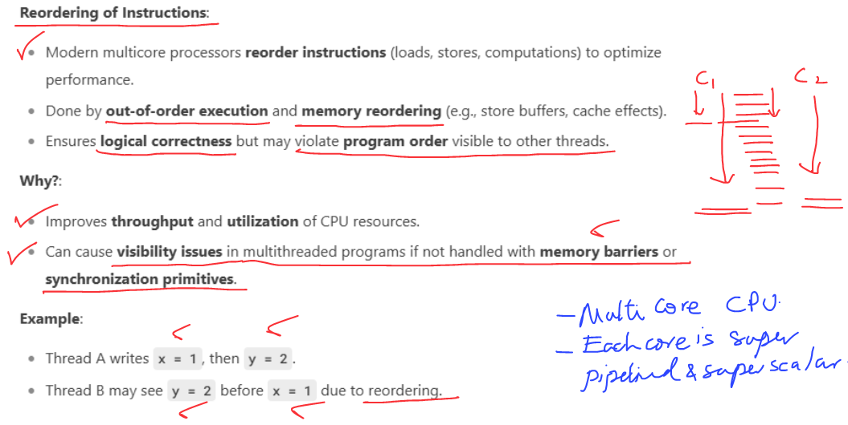
Instruction Reordering

Slide 29
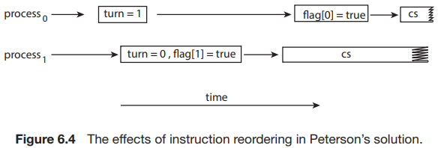
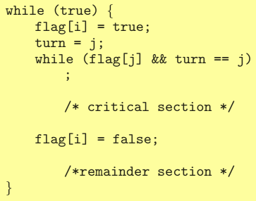
Instruction Reordering and Peterson’s Solution
Consider what happens if the assignments of the first two statements that appear in the entry section of Peterson’s solution in Figure 6.3 are reordered; it is possible that both threads may be active in their critical sections at the same time, as shown in Figure 6.4.

Slide 30
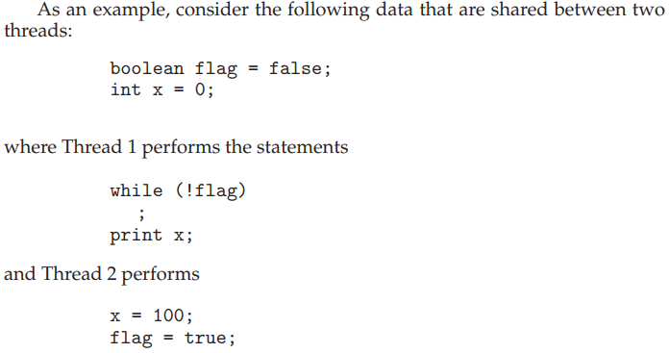
Modern Architecture Example
The expected behavior is, of course, that Thread 1 outputs the value 100 for variable x.
If due to reordering of instructions in Thread 2 so that flag is assigned true before assignment of x = 100.
Thread 1 would output 0 for variable x.
The processor may also reorder the statements issued by Thread 1 and load the variable x before loading the value of flag.
Thread 1 would output 0 for variable x even if the instructions issued by Thread 2 were not reordered.

Slide 31
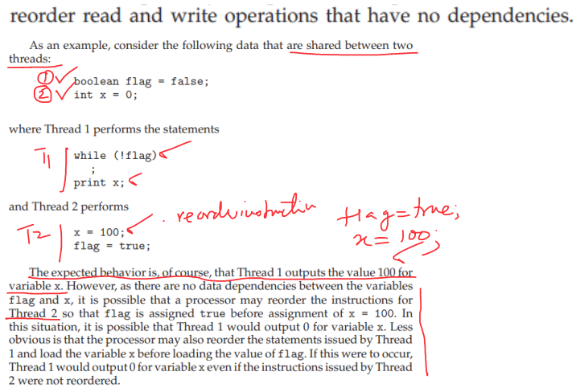
Modern Architecture Example (Cont.)

Slide 32
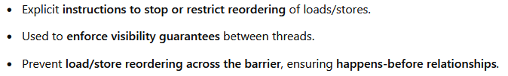
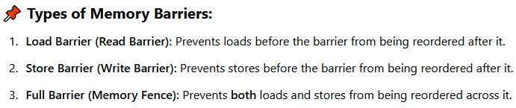
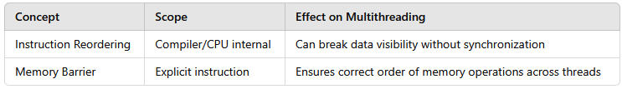
Memory Barrier Instructions
Modern CPUs reorder memory operations for performance, but this can break correctness in multithreaded programs unless synchronization primitives (locks, semaphores) use memory barriers internally.

Slide 33
Memory Barrier Example
Returning to the example of slides 6.17 - 6.18
We could add a memory barrier to the following instructions to ensure Thread 1 outputs 100:
Thread 1 now performs while (!flag) memory_barrier(); print x
Thread 2 now performs x = 100; memory_barrier(); flag = true
For Thread 1 we are guaranteed that that the value of flag is loaded before the value of x.
For Thread 2 we ensure that the assignment to x occurs before the assignment flag.

Slide 34
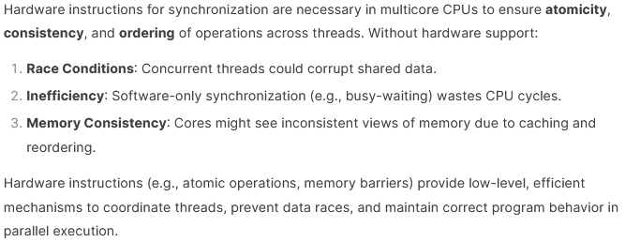
Hardware or Atomic Instructions

Slide 35
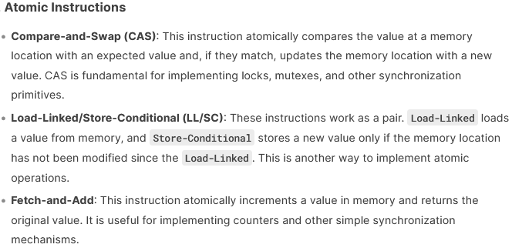
Hardware or Atomic Instructions

Slide 36
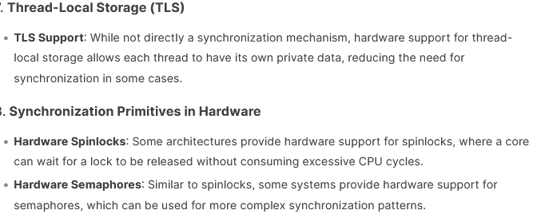
Hardware or Atomic Instructions

Slide 37
Mutex Locks
OS designers build software tools to solve critical section problem
Simplest is mutex lock
Boolean variable indicating if lock is available or not
Protect a critical section by
First acquire() a lock
Then release() the lock
Calls to acquire() and release() must be atomic
Usually implemented via hardware atomic instructions such as compare-and-swap.
But this solution requires busy waiting
This lock therefore called a spinlock

Slide 38
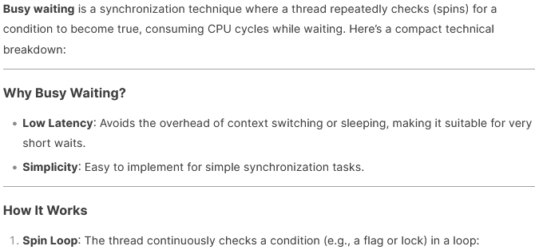
Busy Waiting

Slide 39
Busy Waiting
Technical Details:
CPU Usage: Consumes 100% CPU on the waiting core, wasting resources.
No OS Involvement: Does not involve the OS scheduler, reducing latency for very short waits.
Starvation Risk: If the condition is never met, the thread spins indefinitely.

Slide 40
Busy Waiting
Use cases:
Short Waits: Ideal for very short critical sections or low-contention scenarios.
Real-Time Systems: Used in real-time systems where predictable latency is critical.
Spinlocks: Common in kernel-level programming for lightweight synchronization.
Alternatives:
Blocking Waits: Use OS primitives like pthread_cond_wait or semaphores to sleep the thread, freeing CPU resources.

Slide 41
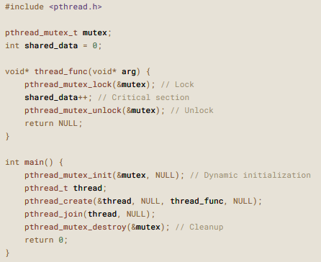
Solution to CS Problem Using Mutex Locks

Slide 42
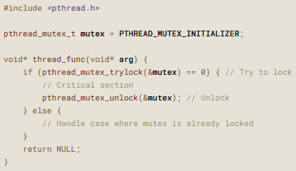
Solution to CS Problem Using Mutex Locks

Slide 43
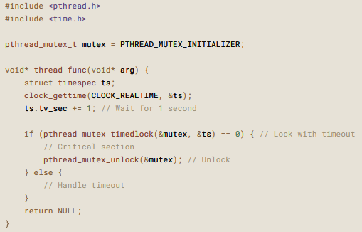
Solution to CS Problem Using Mutex Locks

Slide 44
Semaphore
Synchronization tool that provides more sophisticated ways (than Mutex locks) for processes to synchronize their activities.
Semaphore S – integer variable
Can only be accessed via two indivisible (atomic) operations
wait() and signal()
Originally called P() and V()
Definition of the wait() operation
wait(S) {
while (S <= 0)
; // busy wait
S--;
}
Definition of the signal() operation
signal(S) {
S++;
}

Slide 45
Semaphore (Cont.)
Counting semaphore – integer value can range over an unrestricted domain
Binary semaphore – integer value can range only between 0 and 1
Same as a mutex lock
Can implement a counting semaphore S as a binary semaphore
With semaphores we can solve various synchronization problems

Slide 46
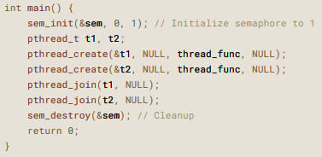
Semaphore Usage Example
Semaphore creation in main() common to all examples.
pshared determines whether the semaphore is shared between threads or processes. 0 for thread synchronization.

Slide 47
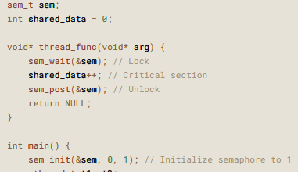
Semaphore Usage Example
Basic Mutual Exclusion - Ensure only one thread accesses a critical section at a time.

Slide 48
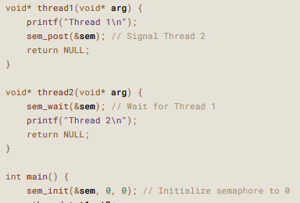
Semaphore Usage Example
Ordering Thread Execution - Ensure one thread executes before another.

Slide 49
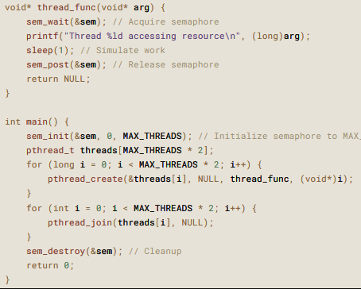
Semaphore Usage Example
Limiting Concurrent Access - Limit the number of threads accessing a resource simultaneously.

Slide 50
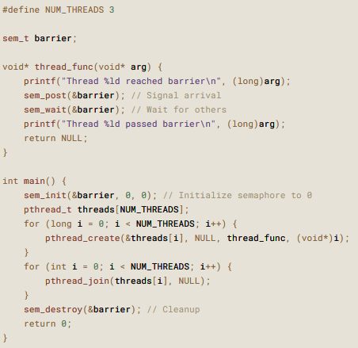
Semaphore Usage Example
Barrier Synchronization - Wait for all threads to reach a point before proceeding.

Slide 51
Ordering two statement in two different processes using a semaphore
Consider P₁ and P₂ that with two statements S₁ and S₂ and the requirement that S₁ to happen before S₂
Create a semaphore “synch” initialized to 0
P1:
S₁;
signal(synch);
P2:
wait(synch);
S₂;

Slide 52
Semaphore Implementation with no Busy waiting
With each semaphore there is an associated waiting queue
Each entry in a waiting queue has two data items:
Value (of type integer)
Pointer to next record in the list
Two operations:
block – place the process invoking the operation on the appropriate waiting queue
wakeup – remove one of processes in the waiting queue and place it in the ready queue

Slide 53
Implementation with no Busy waiting (Cont.)
wait(semaphore *S) {
S->value--;
if (S->value < 0) { add this process to S->list;
block();
}
}
signal(semaphore *S) {
S->value++;
if (S->value <= 0) { remove a process P from S->list;
wakeup(P);
}
}
typedef struct {
int value;
struct process *list;
} semaphore;

Slide 54

Liveness is a property of concurrent systems ensuring that desired events or actions eventually occur, despite delays or interference from other threads. It guarantees progress and prevents scenarios like:
Deadlock: Threads block indefinitely, each holding a resource needed by another.
Starvation: A thread is perpetually denied resources, preventing progress.
Livelock: Threads keep retrying an operation but make no progress due to repeated interference.

Slide 55
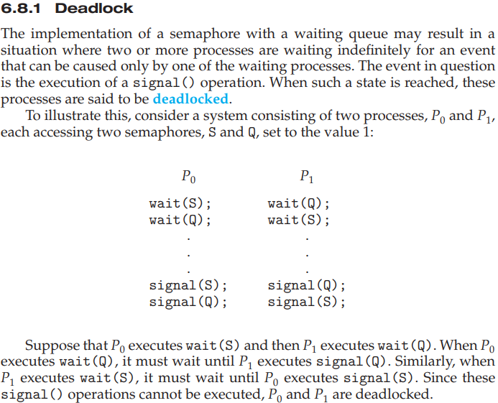

Slide 56
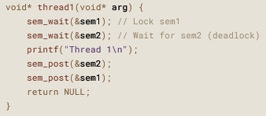
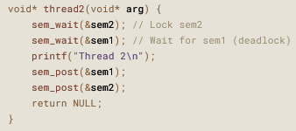

Pthread C code for Deadlock

Slide 57
End of Chapter 6

